Slide 1
October 2021
Pre-Separation
Counseling

Slide 2
DISCLAIMER
The information provided herein does not constitute a formal endorsement of any company, its products, or services by the U.S. Department of Defense (DoD). Specifically, the appearance or use of external hyperlinks does not constitute endorsement by the DoD of the linked websites or the information, products, or services contained therein. The DoD does not exercise any editorial control over the information you may find at these locations. While this information provides informational resource material to assist military personnel and their families in identifying or exploring resources and options, the resources provided are not exhaustive.
RG, p. 5

Slide 3
PRE-SEPARATION COUNSELING
RESOURCE GUIDE
1. Go to: www.dvidshub.net/unit/DoDTAP
2. Scroll down to Recent Publications on DVIDS
3. Select the 2022 DoD Pre-Separation Counseling Resource Guide
4. Download and save or email the Resource Guide
NOTE: The corresponding page of the Resource Guide (RG) will appear in
the left, bottom corner of each slide in this brief.
RG, p. 92

Slide 5
10 STEPS TO TRANSITION
STEP 1: Plan for Your Transition
STEP 2: Build Your Transition Team
STEP 3: Know Your VA Benefits
STEP 4: Plan for Health/Mental Care and Health Insurance
STEP 5: Plan for Civilian Employment/Vocational Training
STEP 6: Learn About Federal Employment
STEP 7: Plan for Further Education
STEP 8: Consider Starting a Business
STEP 9: Explore Additional Information and Benefits
STEP 10: Know Where to Go for Assistance
RG, p. 6

Slide 6
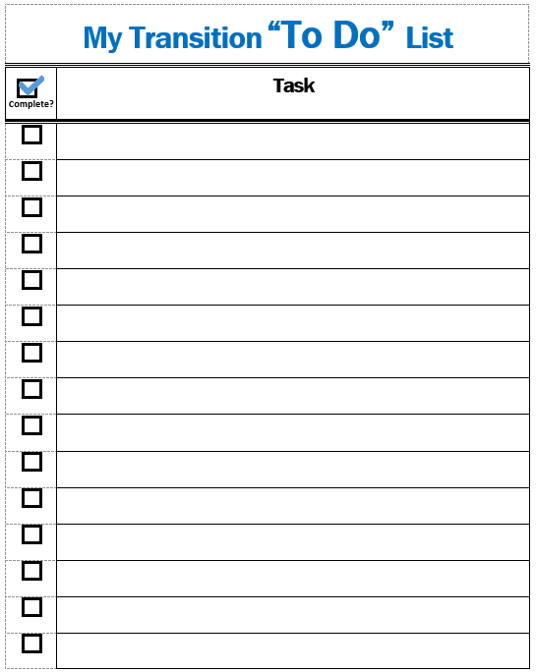
MY TRANSITION “TO DO” LIST AND NOTES PAGE
ACTIVITY
Throughout this brief, add the tasks you need to complete or take notes as you prepare for transition.
RG, p. 6

Slide 7
STEP 1:
Plan for Your Transition
STEP 2: Build Your Transition Team
STEP 3: Know Your VA Benefits
STEP 4: Plan for Health/Mental Care and Health Insurance
STEP 5: Plan for Civilian Employment/Vocational Training
STEP 6: Learn About Federal Employment
STEP 7: Plan for Further Education
STEP 8: Consider Starting a Business
STEP 9: Explore Additional Information and Benefits
STEP 10: Know Where to Go for Assistance
RG, p. 7

Slide 8
TRANSITION ASSISTANCE PROGRAM (TAP)
Congressionally mandated program that provides information, tools and training to ensure Service members and their spouses are prepared for the next step in civilian life.
Title 10 U.S.C., Sections 1142, 1143, 1144
NDAA FY 19 John S. McCain, Section 552—Improvements to TAP
NDAA FY20, Sections 570c, 570f
DoDI 1332.35—TAP for Military Personnel
RG, p. 7

Slide 9
TAP OVERVIEW
You are here
Individualized Initial Counseling (IC)
Pre-Separation Counseling
Managing Your (MY) Transition
NLT 365 days
DoD Transition Day
DOL Employment Fundamentals of Career Transition
VA Benefits and Services
Financial Planning for Transition
MOC Crosswalk
2-Day Tracks
Continuum of Service
Capstone
Employment
Vocational
Education
Entrepreneurship
NLT 90 Days
RG, p. 8

Slide 10
CAREER
READINESS
STANDARDS
Individualized Initial Counseling
Deliverables assigned
CRS
Ensure you are ready for transition.
TAP Modules
Deliverables initiated
Capstone
Deliverables verified
RG, p. 8

Slide 11
GETTING STARTED
INDIVIDUALIZED INITIAL COUNSELING
CRS
Complete a personal self-assessment
Initiate an Individualized Transition Plan (ITP)
PRE-SEPARATION COUNSELING
RG, p. 8

Slide 12
INDIVIDUAL TRANSITION PLAN (ITP)
This slide is included for sites to add Service-specific
information about the ITP or a transition checklist.
See font and color details below.
HIDE slide if not used; do not DELETE slide as it may be needed for future presentations.
Title Font: 48-54 pts - Franklin Gothic Medium, All CAPS. | Body Font: Minimum 18 pts - Calibri Body Color Codes: Dark Blue - RGB (R: 30, G: 61, B: 88) | Light Blue - RBG (R: 0, G: 176, B: 240)
RG, p. 9

Slide 13
DD FORM 2648
Service Member Pre-Separation/Transition Counseling and Career Readiness Standards eForm for Service Members Separating, Retiring, Released from Active Duty (REFRAD)
DD eFORM 2648 tracks completion of all TAP requirements.
Initial Counseling: Initiated
Pre-Separation Counseling: e-Sign
Capstone: e-Sign
Filed in official military record
Save copy for your records
RG, p. 9

Slide 14
TAP CORE CURRICULUM:
DoD/DHS Transition Day
MANAGING YOUR (MY) TRANSITION
MOC CROSSWALK
CRS
Complete a Gap Analysis or provide verification of employment
FINANCIAL PLANNING FOR TRANSITION
CRS
Prepare a criterion-based, post-separation financial plan
RG, p.10
RG, p. X

Slide 15
TAP CORE CURRICULUM:
VA Benefits and Services
CRS
Register on VA.gov
RG, p. 11
RG, p. X

Slide 16
TAP CORE CURRICULUM:
DOL one-day workshop
Employment Fundamentals for Career Transition (EFCT)
Introduces the essential tools and resources to evaluate career options
Provides key information for civilian employment
Explains the fundamentals of the employment process
RG, p. 11

Slide 17
EMPLOYMENT
2-DAY
TRACKS
CRS
Complete a resume or provide verification of employment
VOCATIONAL
CRS
Complete a comparison of technical training institution options
EDUCATION
CRS
Complete a comparison of higher education institution options
ENTREPRENEURSHIP
RG, p. 12
17

Slide 18
2-DAY TRACKS
This slide is included for sites to add site-specific information
on registration for upcoming 2-Day Track modules.
See font and color details below.
HIDE slide if not used; do not DELETE slide as it may be needed for future presentations.
Title Font: 48-54 pts - Franklin Gothic Medium, All CAPS. | Body Font: Minimum 18 pts - Calibri Body Color Codes: Dark Blue - RGB (R: 30, G: 61, B: 88) | Light Blue - RBG (R: 0, G: 176, B: 240)
RG, p. 12

Slide 19
CONTINUUM OF MILITARY SERVICE OPPORTUNITY
This slide is included for sites to add site-specific information about the
Continuum of Military Service Opportunity (Active-Component only) counseling.
See font and color details below.
HIDE slide if not used; do not DELETE slide as it may be needed for future presentations.
Title Font: 48-54 pts - Franklin Gothic Medium, All CAPS. | Body Font: Minimum 18 pts - Calibri Body Color Codes: Dark Blue - RGB (R: 30, G: 61, B: 88) | Light Blue - RBG (R: 0, G: 176, B: 240)
RG, p. 12

Slide 20
CAPSTONE
This slide is included for sites to add site-specific
information about the Capstone process.
See font and color details below.
HIDE slide if not used; do not DELETE slide as it may be needed for future presentations.
Title Font: 48-54 pts - Franklin Gothic Medium, All CAPS. | Body Font: Minimum 18 pts - Calibri Body Color Codes: Dark Blue - RGB (R: 30, G: 61, B: 88) | Light Blue - RBG (R: 0, G: 176, B: 240)
RG, p. 13

Slide 21
CAREER
READINESS
STANDARDS
Completed | CRS | Course/Brief
 | Start a personal self-assessment/ Individual Transition Plan (ITP) | IC/Pre-Separation Counseling
 | Complete a Gap Analysis or provide verification of employment | MOC Crosswalk
 | Prepare a criterion-based, post-separation financial plan | Financial Planning for Transition
 | Register on VA.gov | VA Benefits and Services
 | Complete a resume or provide verification of employment | DOL Employment Workshop
 | Complete a comparison of higher education or technical training institution options | DoD Managing Your Education/ DOL Career Credential Exploration
 | Complete a continuum of Military Service Opportunity counseling (Active-component only) | By Installation
RG, p. 14

Slide 22
DS LOGON
Secure means of authentication for websites with PII and PHI
Best created with a CAC
Created during VA Benefits and Service
Websites requiring DS Logon include:
MilConnect
DFAS
VA.gov (VA Benefits and Services)
TRICARE On Line
RG, p. 15
RG, p. X

Slide 23
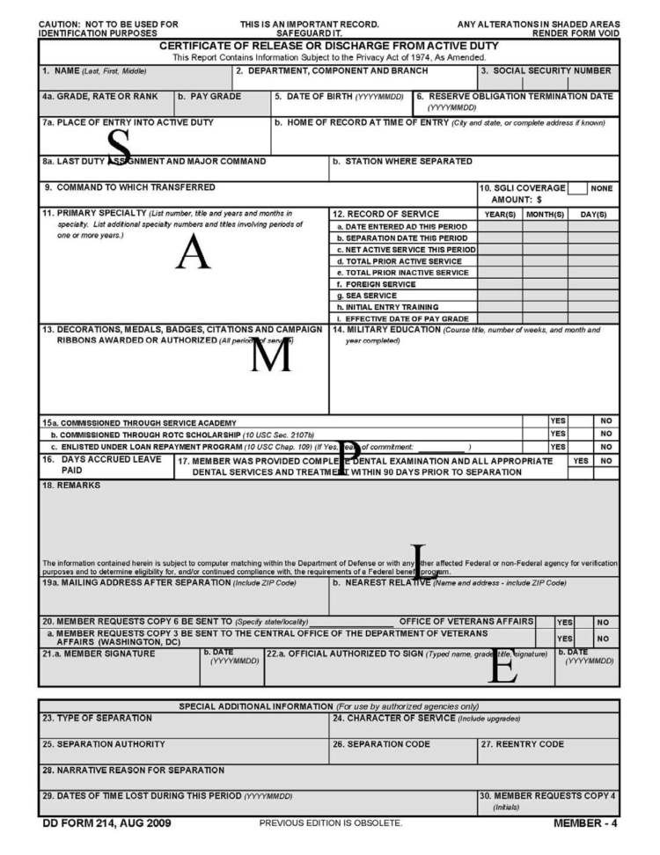
DD Form 214
Certificate of Release or Discharge
from Active Duty
Your DD 214 is the key to
unlocking all future benefits.
BEFORE TRANSITION:
Review the dates and locations of Service on your DD 214 CAREFULLY.
Have mistakes corrected.
Safeguard your DD 214!
RG, p. 15

Slide 24
MY transition timeline
Located on
www.DoDTAP.mil under Resources/FAQs
RG, p. 16

Slide 25
SERVICE TRANSITION TIMELINE
This slide is included for sites to add a Service-specific transition timeline.
See font and color details below.
HIDE slide if not used; do not DELETE slide as it may be needed for future presentations.
Title Font: 48-54 pts - Franklin Gothic Medium, All CAPS. | Body Font: Minimum 18 pts - Calibri Body Color Codes: Dark Blue - RGB (R: 30, G: 61, B: 88) | Light Blue - RBG (R: 0, G: 176, B: 240)
RG, p. 16

Slide 26
STEP 1: Plan for Your Transition
STEP 2:
Build Your Transition Team
STEP 3: Know Your VA Benefits
STEP 4: Plan for Health/Mental Care and Health Insurance
STEP 5: Plan for Civilian Employment/Vocational Training
STEP 6: Learn About Federal Employment
STEP 7: Plan for Further Education
STEP 8: Consider Starting a Business
STEP 9: Explore Additional Information and Benefits
STEP 10: Know Where to Go for Assistance
RG, p. 18

Slide 27
Installation Resources
YOUR
TRANSITION
TEAM
Military & Family Support Staff
Service Transition or TAP Office
VA Benefits Advisor
Chaplains, Health Professionals, Education Office
Off-installation Resources
American Job Centers
Vet Centers
Military OneSource
Military and Veteran Service Organizations
RG, p. 18

Slide 28
ADDITIONAL
SUPPORT SOURCES
Family Members
Military Colleagues
Veterans
Mentors
Social Network
National Resource Directory (NRD)
RG, p. 20

Slide 29
MILITARY LIFE CYCLE (MLC) COURSES
Transitioning to Federal Employment
Reserve Component Dual Payments
Social and Emotional Health Resources
Survivor and Casualty Assistance Resources
VA Benefits 101
VA Education Benefits
VA Home Loan Guaranty Program
VA Life Insurance Benefits
Vet Centers
RG, p. 21

Slide 30
TAP TRANSITION
ONLINE LEARNING (TOL)
Managing Your (MY) Transition
MOC Crosswalk
Financial Planning for Transition
VA Benefits and Services
Employment Fundamentals for Career Transition
www.TAPevents.org
DOL Employment Track: Employment Workshop (DOLEW)
DOL Vocational Track: Career and Credential Exploration (C2E)
DOD Education Track: Managing Your (MY) Education (MYE)
SBA Entrepreneurship Track: Boots to Business (B2B)
RG, p. 22

Slide 31
STEP 1: Plan for Your Transition
STEP 2: Build Your Transition Team
STEP 3:
Know Your VA Benefits
STEP 4: Plan for Health/Mental Care and Health Insurance
STEP 5: Plan for Civilian Employment/Vocational Training
STEP 6: Learn About Federal Employment
STEP 7: Plan for Further Education
STEP 8: Consider Starting a Business
STEP 9: Explore Additional Information and Benefits
STEP 10: Know Where to Go for Assistance
RG, p. 23

Slide 32
VA BENEFITS AND SERVICES
VA Benefits Advisors discuss VA benefits over 6 modules:
Navigating the Journey
Supporting Yourself and Your Family
Getting Career Ready
Finding a Place to Live
Maintaining Your Health
Connecting with Your Community
1
2
3
4
5
6
RG, p. 23

Slide 33
VA Information –
Resource guide
VA Education and Training Benefits
Personalized Career Planning and Guidance (PCPG)
Veteran Readiness & Employment (VR&E)
VA Home Loan Guarantee
VA Life Insurance
VA Vet Centers
VA Solid Start
VA Disability
VA Health Administration
VA Health Care
VA Women’s Health
Transition Care Management (TCM)
VA Mental Health Care
VA Dental Care
RG, p. 24

Slide 34
VA DISABILITY BENEFITS:
Benefits Delivery at Discharge
What
Benefits Delivery at Discharge (BDD) provides VA disability compensation (pay) from day of discharge.
Service members meeting the requirements begin the BDD claim process within 180 – 90 days from discharge.
Meet with a VA Benefits Advisor to determine if this option is right for you.
Who
How
RG, p. 25

Slide 35
TRANSFER OF BENEFITS
Failure to complete the obligated Service before separating may require any benefits used to be repaid.
Criteria for active-duty Service member to transfer Post-9/11 GI Bill benefits
Served a minimum of 6 years
Agree to add 4 more years of Service
Recipient of benefits has enrolled in DEERS
AND
AND
RG, p. 29

Slide 36
VA SOLID START
Follow up phone calls from VA at 90, 180, 365 days after separation
Reminder emails with links to resources
Update contact information at VA.gov prior to separation/retirement
RG, p. 34

Slide 37
VA BENEFITS ADVISOR(S)
This slide is included for sites to add contact information for their site VA Benefits Advisor(s). See font and color details below.
HIDE slide if not used; do not DELETE slide as it may be needed for future presentations.
Title Font: 48-54 pts - Franklin Gothic Medium, All CAPS. | Body Font: Minimum 18 pts - Calibri Body Color Codes: Dark Blue - RGB (R: 30, G: 61, B: 88) | Light Blue - RBG (R: 0, G: 176, B: 240)

Slide 38
STEP 1: Plan for Your Transition
STEP 2: Build Your Transition Team
STEP 3: Know Your VA Benefits
STEP 4:
Plan for Health/Mental Care and Health Insurance
STEP 5: Plan for Civilian Employment/Vocational Training
STEP 6: Learn About Federal Employment
STEP 7: Plan for Further Education
STEP 8: Consider Starting a Business
STEP 9: Explore Additional Information and Benefits
STEP 10: Know Where to Go for Assistance
RG, p. 35

Slide 39
Required Health Assessments
TRICARE Online contains a Service Separation tab which provides the steps necessary to start the process.
SEPARATION HISTORY
AND PHYSICAL
EXAMINATION (SHPE)
OR
SEPARATION HEALTH ASSESSMENT (SHA)
AND
MENTAL HEALTH ASSESSMENT (MHA)
Either SHPE (DoD conducted) or SHA (VA conducted) is required prior to separation or release from active duty.
Either SHA (VA conducted) or SHPE (DoD conducted) is required prior to separation or release from active duty.
MHA is required prior to SHPE or SHA and will be included as part of the appointment.
SHA is required for VA disability claims.
Confirm your Service Treatment Record (STR) or Military Medical Record includes all medical aid received on AND off installation.
!
RG, p. 35

Slide 40
DoD inTRANSITION PROGRAM
Available to ALL Service members regardless of length of Service or discharge status
No expiration date to enroll
Free, confidential coaching and assistance for Service members who require mental health services.
Automatically enrolled if seen by a behavioral health provider within 1 year of separation from active duty*
RG, p. 37
*May opt out

Slide 41
VETERANS/MILITARY CRISIS LINE
Save this information in your phone to assist friends and family
Text: 838255
Call: 1-800-2738255; Press 1
Chat: www.VeteransCrisisLine.net
RG, p. 38

Slide 42
SEXUAL ASSAULT
PREVENTION AND
RESPONSE
PROGRAM
Sexual harassment
Sexual assault
Intimate Partner Violence (IPV)
Contact your unit or installation SAPR Victim Advocate or Safe Helpline if you have been a victim of Sexual Assault
RG, p. 39

Slide 43
TRICARE HEALTH CARE PLAN
Schedule an appointment with TRICARE representative.
Visit the Plan Finder on the TRICARE website.
Retirees who fail to enroll in TRICARE Prime or TRICARE Select will lose all TRICARE coverage.
RG, p. 40

Slide 44
TRANSITIONAL/TEMPORARY
HEALTH CARE COVERAGE
Continued Health Care Benefits Program (CHCBP)
Transitional Assistance Management Program (TAMP)
RG, p. 43

Slide 45
HEALTH INSURANCE
MARKETPLACE
The Marketplace helps uninsured people find health coverage.
Plans cover essential health benefits, pre-existing conditions, and preventive care.
More information will be provided during the Financial Planning for Transition module.
RG, p. 46

Slide 46
STEP 1: Plan for Your Transition
STEP 2: Build Your Transition Team
STEP 3: Know Your VA Benefits
STEP 4: Plan for Health/Mental Care and Health Insurance
STEP 5:
Plan for Civilian Employment/Vocational Training
STEP 6: Learn About Federal Employment
STEP 7: Plan for Further Education
STEP 8: Consider Starting a Business
STEP 9: Explore Additional Information and Benefits
STEP 10: Know Where to Go for Assistance
RG, p. 48

Slide 47
DOL
EMPLOYMENT
TRACK:
Employment Workshop
(DOLEW)
Identifying Skills
Job Searching
Networking
Resume Building
Federal Hiring
Social Media
Branding
Applications
Interviews
Job Offers
EMPLOYMENT
CRS
Complete a resume or provide verification of employment
RG, p. 48
47

Slide 48
DOL VOCATIONAL
TRACK:
Career and Credentialing Exploration (C2E)
Vocational Training
Career Clusters
Career Assessments
Resources
Labor Markets
Experience Opportunities
Credentials
Educational Goals
Career Action Plan
VOCATIONAL
CRS
Complete a comparison of technical training institution options
RG, p. 48
48

Slide 49
DOL Transition Employment Assistance
for Military Spouses (TEAMS)
Your Next Move
Career Credentials
Marketing Me
Resume Essentials
Federal Hiring
Interview Skills
LinkedIn Profiles/Job Search
Salary Negotiations
RG, p. 49

Slide 50
DOL RESOURCES
Career One Stop website
American Job Centers (AJC)
Priority of Service
State Job Banks
Unemployment Compensation
RG, p. 50
50

Slide 51
IDENTIFYING SKILLS & INTERESTS
O*NET Online
Interest Profiler
My Next Move for Veterans
Verification of Military Experience and Training
(VMET)
DD Form 2586
RG, p. 52

Slide 52
CREDENTIALING
Licenses
Certifications
Credentialing Opportunities On-Line (COOL)
MilGears
RG, p. 54

Slide 53
GAINING EXPERIENCE
Apprenticeships/OJT
United States Military Apprenticeship Program (USMAP)
DoD SkillBridge
Volunteering
AmeriCorps
RG, p. 57

Slide 54
UNIFORMED SERVICE EMPLOYMENT AND REEMPLOYMENT RIGHTS ACT (USERRA)
Federal law that establishes rights and responsibilities for uniformed Service members and their civilian employers
Active Duty, National Guard, and Reserve Members covered by USERRA
More information provided during DOL modules
RG, p. 60

Slide 55
STEP 1: Plan for Your Transition
STEP 2: Build Your Transition Team
STEP 3: Know Your VA Benefits
STEP 4: Plan for Health/Mental Care and Health Insurance
STEP 5: Plan for Civilian Employment/Vocational Training
STEP 6:
Learn About Federal Employment
STEP 7: Plan for Further Education
STEP 8: Consider Starting a Business
STEP 9: Explore Additional Information and Benefits
STEP 10: Know Where to Go for Assistance
RG, p. 63

Slide 56
FEDERAL EMPLOYMENT OPPORTUNITIES
Feds Hire Vets and USAJobs
Veterans Preference
Special Appointing Authority for Veterans
Veterans Employment Opportunities Act (VEOA)
Veterans Recruitment Appointment (VRA)
Thirty Percent or More Disabled Veterans
RG, p. 63

Slide 57
180-Day Restriction on DoD
Employment of Military Retirees
POST-MILITARY
EMPLOYMENT
RESTRICTIONS
Post-Government (Military) Service
Employment Restriction Counseling
RG, p. 66

Slide 58
STEP 1: Plan for Your Transition
STEP 2: Build Your Transition Team
STEP 3: Know Your VA Benefits
STEP 4: Plan for Health/Mental Care and Health Insurance
STEP 5: Plan for Civilian Employment/Vocational Training
STEP 6: Learn About Federal Employment
STEP 7:
Plan for Further Education
STEP 8: Consider Starting a Business
STEP 9: Explore Additional Information and Benefits
STEP 10: Know Where to Go for Assistance
RG, p. 69

Slide 59
DoD EDUCATION
TRACK:
Managing Your (MY) Education
Education Terms
Reasons for Earning a Degree
Choosing a Field of Study
Degree Options
Choosing an Institution
Gaining Admission
Transfer Credit
Funding Options
EDUCATION
CRS
Complete a comparison of higher education institution options
RG, p. 69
59

Slide 60
EDUCATION ASSISTANCE
RESOURCES
Service Education Counselors resources:
College level-testing
Veterans’ Benefits
Tuition Assistance
Financial Aid Assistance
Deferments for military service
DANTES sponsored resources:
Kuder Journey
Online Academic Skills Training for College Prep/Placement Tests
CLEP or College Credit-by-Exam
Military Training Evaluation Program (MTEP)
Joint Service Transcript (JST)
Community College of Air Force (CCAF) Transcript
RG, p. 66

Slide 61
STATE AND
FEDERAL PROGRAMS
State and Local Educational Benefits
Department of Education Federal Programs/Benefits:
Federal Student Aid—Complete the FAFSA by October 1st
Grants
Loans
Work-Study Programs
Veterans Upward Bound Program
RG, p. 72

Slide 62
STEP 1: Plan for Your Transition
STEP 2: Build Your Transition Team
STEP 3: Know Your VA Benefits
STEP 4: Plan for Health/Mental Care and Health Insurance
STEP 5: Plan for Civilian Employment/Vocational Training
STEP 6: Learn About Federal Employment
STEP 7: Plan for Further Education
STEP 8:
Consider Starting a Business
STEP 9: Explore Additional Information and Benefits
STEP 10: Know Where to Go for Assistance
RG, p. 74

Slide 63
SBA ENTREPRENEURSHIP
TRACK:
Boots to Business (B2B)
Fundamentals
Opportunities
Market Research
SmallBiz Economics
Legal
Financing
ENTREPRENEURSHIP
RG, p. 74
63

Slide 64
Veteran entrepreneurship is supported by SBA, VA, and DoD through the following legislation and programs:
SBA—Small Business Development Act 1999 created goals for veteran contracts.
DoD Procurement Technical Assistance Center Program helps businesses pursue government contracts.
VA Small and Veteran Business Program provides support to small and veteran businesses.
VETERANS FEDERAL
PROCUREMENT
OPPORTUNITIES &
ASSISTANCE
RG, p. 75

Slide 65
STEP 1: Plan for Your Transition
STEP 2: Build Your Transition Team
STEP 3: Know Your VA Benefits
STEP 4: Plan for Health/Mental Care and Health Insurance
STEP 5: Plan for Civilian Employment/Vocational Training
STEP 6: Learn About Federal Employment
STEP 7: Plan for Further Education
STEP 8: Consider Starting a Business
STEP 9:
Explore Additional Information and Benefits
STEP 10: Know Where to Go for Assistance
RG, p. 77

Slide 66
EXTREMISM
REPORTING METHODS
For an emergency, call 911
FBI-Tips Electronic Tip Form: https://tips.fbi.gov/
Local FBI offices: https://www.fbi.gov/contact-us/field-offices
RG, p. 77

Slide 67
IMMIGRATION STATUS
Request information on immigration status and expedited naturalization:
DD 2648 eForm—Opt in
DD 2648 printed form—Write an “opt in” election in Section XI – REMARKS, item 48
RG, p. 78

Slide 68
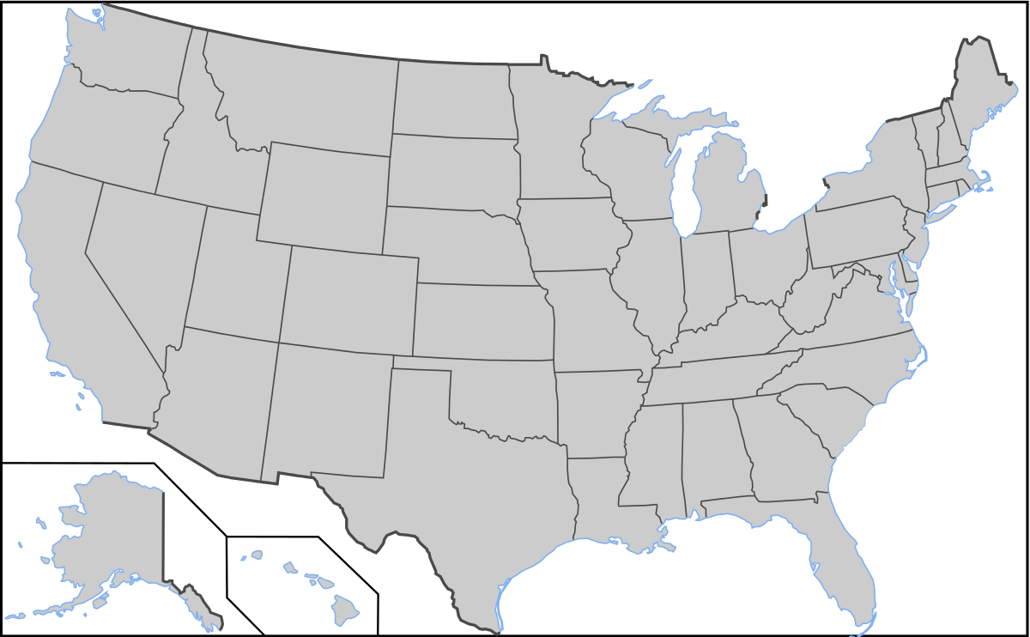
Opt-in FOR STATE information
1
Opt-in with your civilian email on the DD 2648
Indicate the state or states where you may live after transition
State representatives will contact you with information on employment, housing, education, etc.
2
3
RG, p. 78

Slide 69
ADDITIONAL INFORMATION
Separation Pay
Thrift Savings Plan (TSP)
Survivor Benefit Plan (SBP)
Legal Assistance
Military Protections/Tax Benefits
Travel/Transportation Allowances
Permissive TDY/Excess Leave
Housing Assistance/Homelessness
Voting Assistance
Adaptive Tools for Service Members
Commissary, Exchange, MWR
RG, p. 79

Slide 70
STEP 1: Plan for Your Transition
STEP 2: Build Your Transition Team
STEP 3: Know Your VA Benefits
STEP 4: Plan for Health/Mental Care and Health Insurance
STEP 5: Plan for Civilian Employment/Vocational Training
STEP 6: Learn About Federal Employment
STEP 7: Plan for Further Education
STEP 8: Consider Starting a Business
STEP 9: Explore Additional Information and Benefits
STEP 10:
Know Where to Go for Assistance
RG, p. 89

Slide 71
INSTALLATION RESOURCES
This slide is included for sites to add site-specific
information about Installation Resources.
See font and color details below.
HIDE slide if not used; do not DELETE slide as it may be needed for future presentations.
Title Font: 48-54 pts - Franklin Gothic Medium, All CAPS. | Body Font: Minimum 18 pts - Calibri Body Color Codes: Dark Blue - RGB (R: 30, G: 61, B: 88) | Light Blue - RBG (R: 0, G: 176, B: 240)

Slide 72
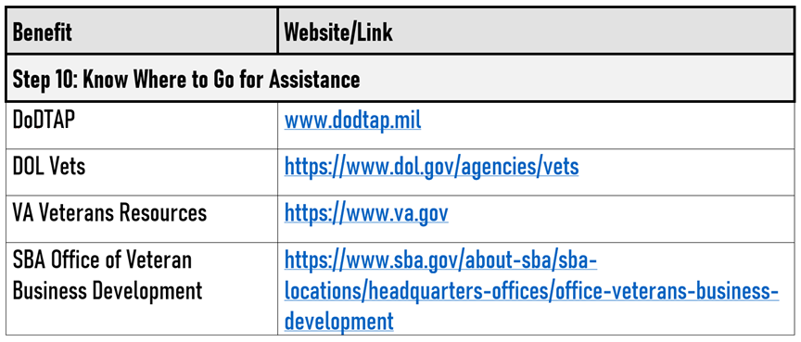
AGENCY PARTNERS & WEBSITES
DoD TAP
DOL VETS
VA.GOV
SBA OVBD
RG, p. 89/92

Slide 73
Embrace the journey. Embrace the change. Growth doesn’t come from things staying the same.
~Unknown
RG, p. 91

Slide 74
QUESTIONS?
Reminder:
We are here to help YOU! If you have any questions at any point during your transition, please let us know.

