Slide 1
Identification Credentials
Veterans Health Identification Card (VHIC)
Note: All VHICs will show “VA Healthcare Enrollee”. Only Veterans that qualify for the special categories (Service Connected, Medal of Honor, Purple Heart, Former POW) will have that category printed on their card. There could be multiple special categories on a VHIC.
*Temporary VA-Issued Letter for Veterans currently ineligible for VHIC (~37K) *

Slide 2
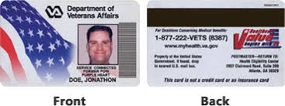
Identification Credentials
Old VHIC cards
Note: There a small number of the old version of the VHIC still in the possession of Veterans eligible under the NDAA 621/10 U.S.C. 1065. If presented, this card is authorized for access to the commissaries, exchanges, and MWR facilities.
Since it is in the old bar code configuration, it may not scan correctly in the DeCA commissary point of sale system and should be visually verified to see it shows the qualifying information on the front of the card e.g. Service Connected, Prisoner of War, Purple Heart, etc.

Slide 3
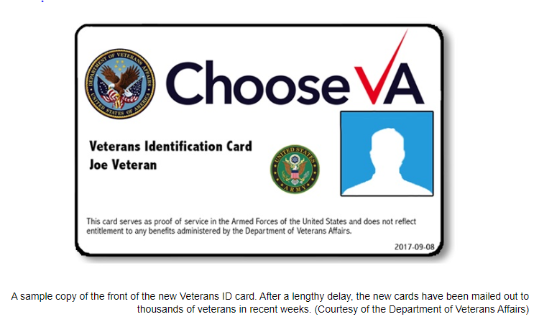
Identification Credentials
Veterans Identification Card (VIC)– is NOT authorized for use under this patronage expansion.
Note: This card serves as proof of service in the Armed Forces of the United States and does not reflect entitlement to any VA or DoD benefits under the 10 U.S.C. Section 1065 patronage expansion and is not valid for access to commissary, exchange, and MWR facilities. Only the VHIC will be accepted.

Slide 4
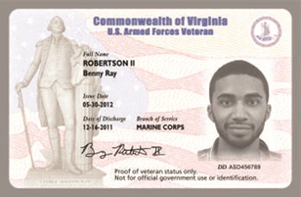
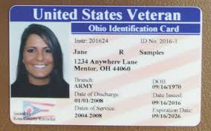
Identification Credentials
State and local issued Veteran’s cards like the examples below are not valid IDs for the purposes of gaining installation access or access to exchange, commissary, and/or MWR privileges

Slide 5
Identification Credentials
Letter for Veterans with a 0% service connected disability not eligible to enroll in VA medical care and not eligible to receive a VHIC may use this VA letter for proof of eligibility
Letters will be sent directly to these Veterans in the December 2019 timeframe

Slide 6
Identification Credentials
Caregivers of Veterans
Caregivers must obtain a letter from the VA that indicates they are the primary family caregiver for a Veteran enrolled in the Program of Comprehensive Assistance for Family Caregivers
For installation access and at point of sale, caregivers will need to show an acceptable credential (e.g., REAL ID-compliant driver’s license, U.S. passport) and their primary family caregiver letter.

